Slide 1
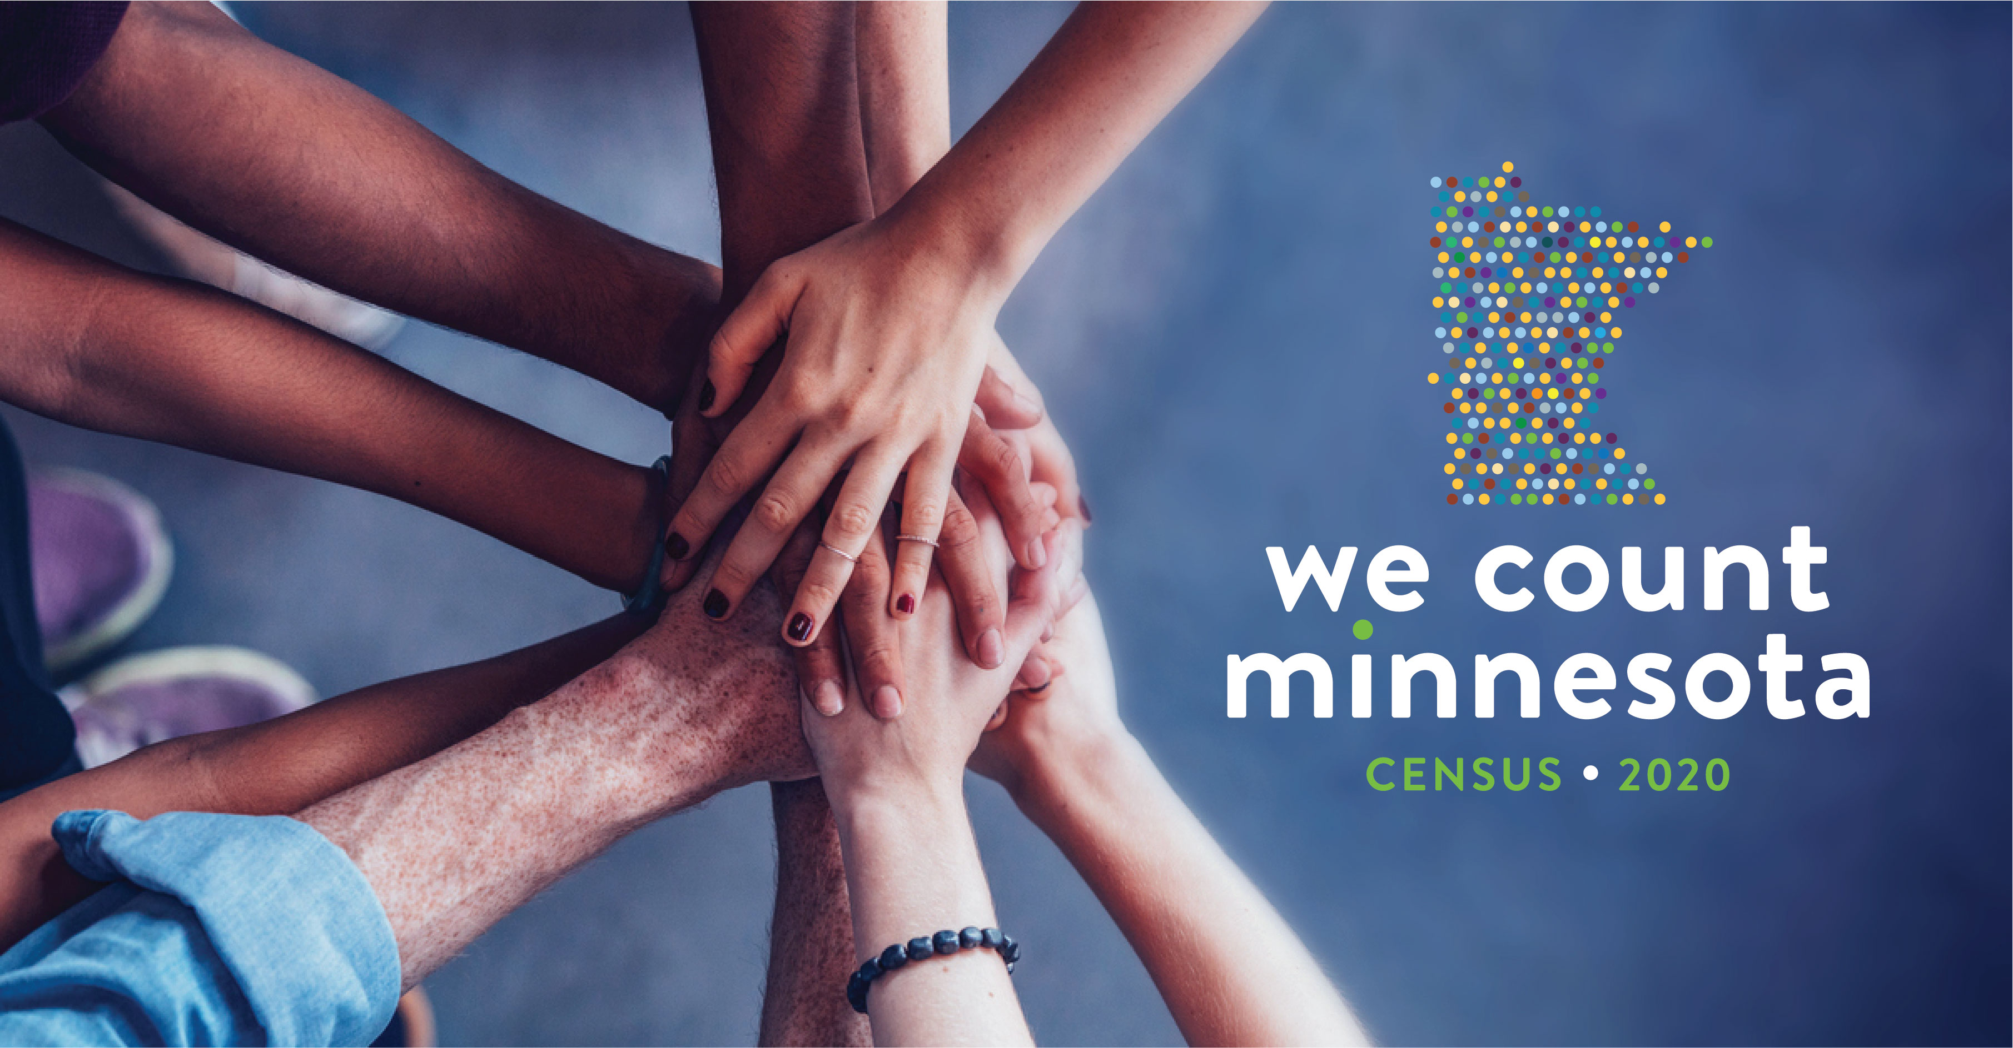
Complete Count Committee Training

Slide 2
Agenda
Introduction
Census Overview
Who do we miss in Minnesota?
Impacts of an undercount and preventing an undercount
Tools for Complete Count Committees
Conclusion and Q&A
Notes:
Review agenda, cognizant of time

Slide 3
Introduction
Notes:
Wondering who I am

Slide 4
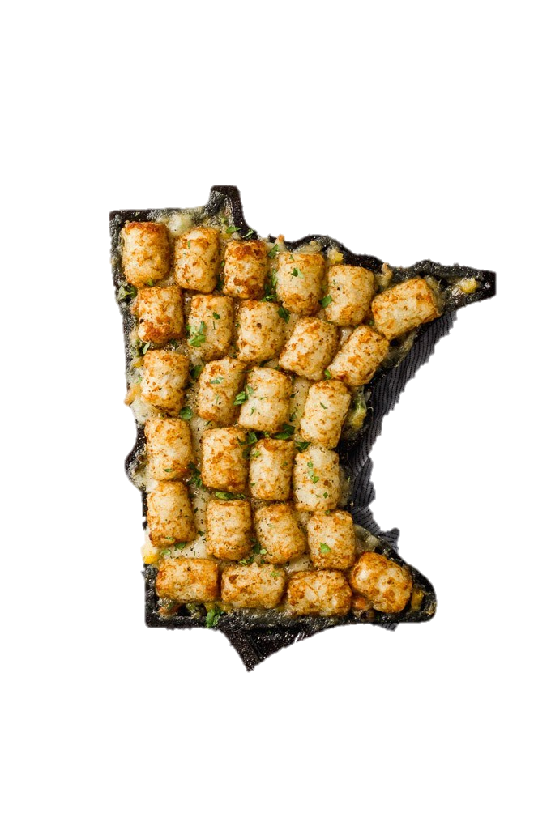
Who am I?
Notes:
Hail from NC, BBQ to hotdish. MN last frontier

Slide 5
Who do I not represent?
Notes:
I do not represent everyone in this room or community but I do represent the communities that I live and work with in, therefore, I am best suited to talk about the census with my community members. Trust takes time to build and disseminating messages about the census through trusted community members is essential. It is important to think about what communities we all live and work within, this could be a faith community, neighborhood community etc. Everyone has something to give!

Slide 6
Me!
Raleigh, NC
Snowpocalypse 2014
Notes:
I also do not represent that Minnesotan that can drive in the snow…

Slide 7
Census Overview
Notes:
Some of you may be census experts, while this may be new for other individuals. Regardless it will be a quick and helpful review.

Slide 8
Census Timeline
First Census conducted in MN
Digitalization of the Census
1790
2010
1849
2020
First Census
Short form only used in Decennial Census
Notes:
1790: First census was taken. Constitutionally mandated
1849: The first census conducted in MN and does anyone know when MN became at state? In 1858 state was granted to MN
2010: First short-form census since 1940. Long form replaced by the ACS.
2020: First digital census

Slide 9
2020 Census Timeline
Reminder letter #3 and paper questionnaire
Enumerators enter the field
Reminder letter #1 and #2
March 12th - 20th
April 1st
April 20th - 27th
March 26th – April 3rd
April 8th – April 16th
April 28th – Until late August
OFFICIAL Census DAY
Final reminder
Invitation to respond
Notes:
-March 12-20: Invitation to respond online to the 2020 Census is distributed to public. 80% of households will receive an invitation to respond via the internet the remainder of households will receive a physical census form. The Bureau estimated 45% will respond online.
-March 26-April 3: If you have NOT responded. A reminder postcard is sent to all households.
-APRIL 1: Census Day. Invited to participate online, mail, or phone.
-April 8 – April 16: IF you have NOT responded a 2nd reminder and paper questionnaire is sent to all households.
-April 20 – April 27th: NOT responded. Final reminder is sent. This is final reminder before census bureau follows-up in person.
-April 28th – Labor Day: End of April through end of august. Census taker go door-to-door collecting info.

Slide 10
Fear around the census
Notes:
We recognize that fear is real and it impacts some communities more than others. I want to emphasize I am here with the State not the bureau and as a state employee and as someone that cares about MN I want to make sure that everyone in this room has the correct information about the census.

Slide 11
Types of Census Forms
Short Form (the most widely distributed)
2. Group Form (i.e. dorm rooms, group living homes, etc.)
3. Form for Native American Reservations

Slide 12
Language Information
The online version and paper version of the census is given in the following 12 languages other than English: Spanish, Chinese, Vietnamese, Korean, Russian, Arabic, Tagalog, Polish, French, Haitian Creole, Portuguese, and Japanese.
The census will provide language guides, language glossaries, and language identification cards in the following languages below:

Slide 13
Language Information
Language Guides: Coming soon from the U.S. Census Bureau.
Language Identification Cards: Allows an individual to identify their language to a Census enumerator.
Language Glossary: Translations of commonly used terms.
Notes:
Language Guides: Help respondents complete the 2020 Census

Slide 14
Do I have to answer every question on the census?
No, you can submit an incomplete Census and still be counted. Partially filled-out questionnaires may result in follow-up phone call or visit from a Census worker.
Notes:
We encourage everyone to fill out every Census questions, but more importantly only answer what you feel comfortable answering.

Slide 15
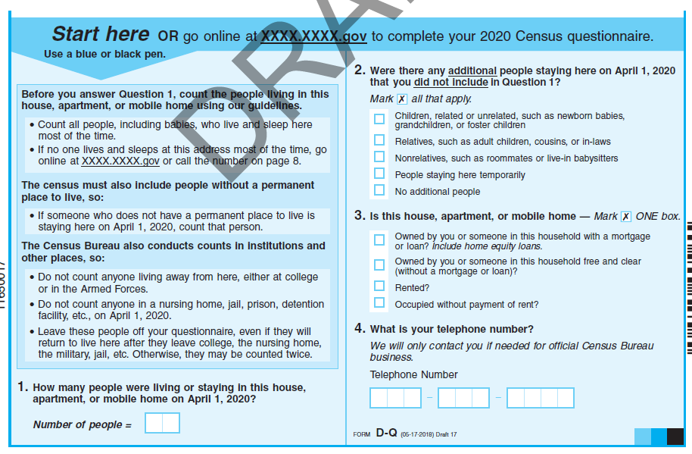
Instructions &
4 questions that apply to the entire household

Slide 16
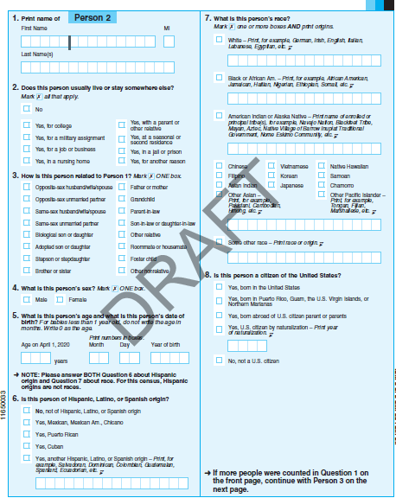
6 questions asked about each person living in the household

Slide 17
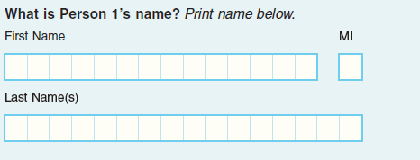
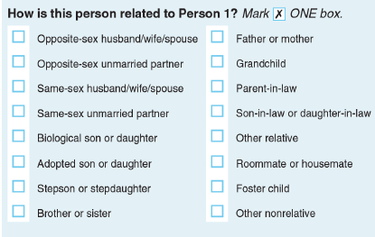
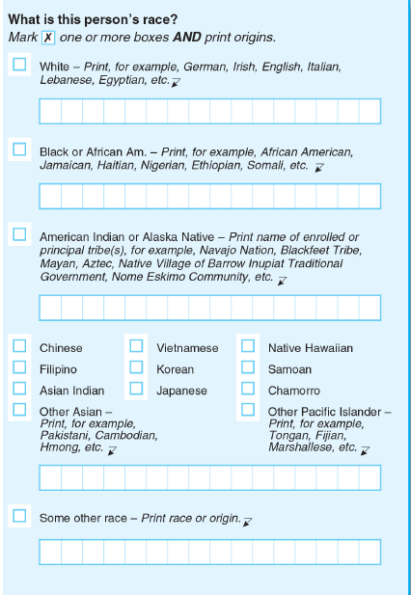
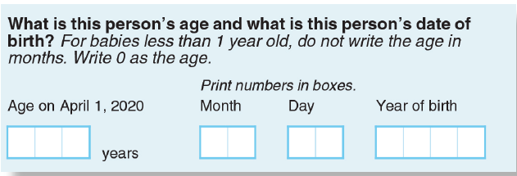
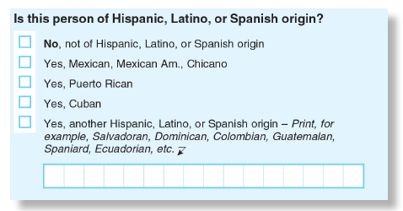
Questions asked about each person in the household
1. Name
2. Relationship to Person 1

Slide 18
Questions asked about each person in the household
3. Sex
4. Age and Date of Birth
5. Hispanic/Latino Ethnicity

Slide 19
Questions asked about each person in the household
6. Race

Slide 20
There will not be a citizenship question on the 2020 Census.

Slide 21
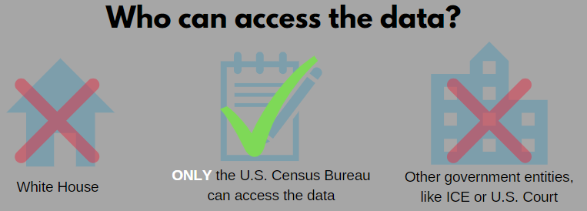
Notes:
Title 13 under Federally law mandates that census data remain confidential. It is against the law for any employee to disclose identifying information. Include a blurb that this information can not be shared with a landlord.

Slide 22
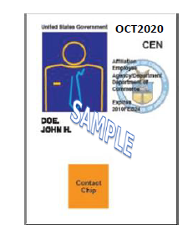
Census Bureau Staff Identification
1. Full Name of Census Worker
2. Photograph of Census Worker
3. Department of Commerce Watermark
4. Expiration date of the badge
5. Identification number
Notes:
The id badge will include the enumerators: full name, photograph, dept of commerce watermark, and an expiration date. Also, have an official census bureau logo and official letterhead and work will only occur between 9am and 9pm.

Slide 23
Important Information
Verify a Census Worker:
Ask of the Census worker to present a badge, identification number, and or letterhead with official Census logo.
2. Call the Chicago Regional Office (1-800-865-6384) or verify via the Census Bureau staff search website (https://www.census.gov/staffsearch).

Slide 24
72 years
2092
Notes:
This is how long your data is protected, story about seeing who live in my house. Ask audience if they know when 72 years from 2020 will be

Slide 25
Who is missed in Minnesota?

Slide 26
Historically, the census has missed certain groups—including young children, people of Color, Indigenous people, and urban and rural low-income households—at disproportionately high rates.

Slide 27
In Minnesota we have…
1,300,000 Renter households
350,000 Children ages 0-4
Young adults, especially the 301,000 students attending a college/university
1,060,000 Racial and Ethnic minorities (Black or African American, American Indian or Alaska Native, Asian Indian, Chinese, Filipino, Other Asian (print option), Japanese, Korean, Vietnamese, Native Hawaiian, Guamanian or Chamorro, Samoan, Other Pacific Islander (print option), and an other category with a print option)
*Based off 2017 American Community Survey (ACS) data
Notes:
These are all groups who are likely to be missed, you can fall in multiple categories. Full list on the website. Make a note that some of these numbers might seem low which is why it is essential that we have a complete count.

Slide 28
Impacts of an undercount

Slide 29
Misallocated Federal funds. Minnesota receives $15,549,175,947 from the government every year. That is $15 billion!
Decreased representation in Washington, D.C. Census data is used to determine congressional seats.
Decreased growth and resources for your community. Census data helps plan roads, schools, hospitals, etc.
Businesses use Census data to locate factories, stores, etc.
Notes:
Misallocated funds example: Circle Pines with money for their road
Decreased Representation: Kept a seat by just over 8000 in the house. North Minneapolis lost a city council seat following the 2010 census redistricting (used to have 3 members and decreased to 2 members have 2012)
Resources/Bussiness: Food deserts and Aldi. Target locating stores throughout the state – know where to sell stuff etc.

Slide 30
2010 Congressional Reapportionment

Slide 31
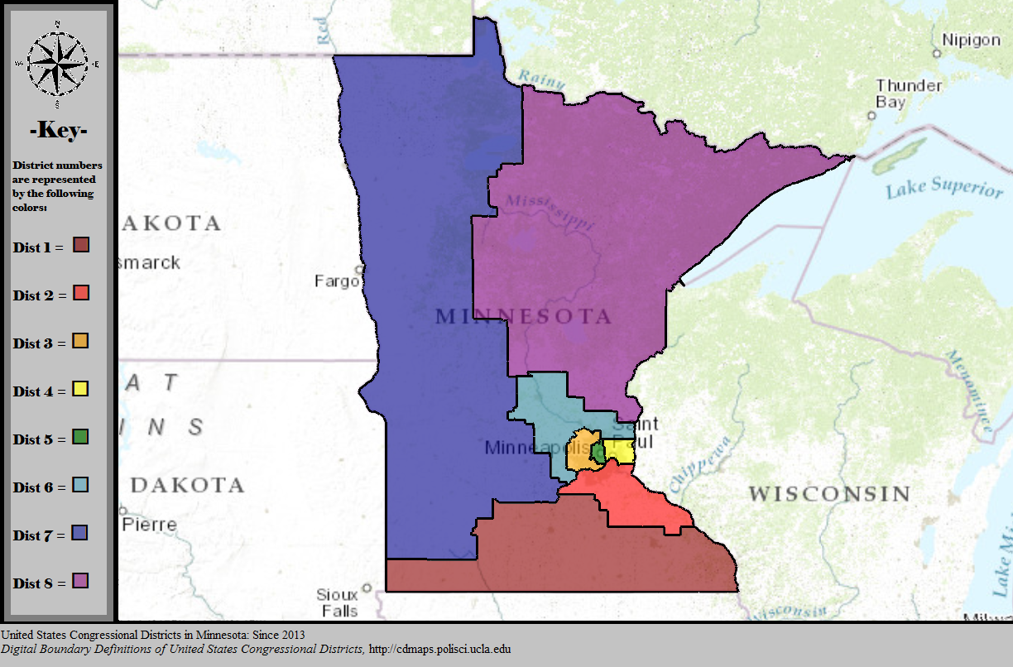
How might Minnesota congressional districts change if the state were to lost a seat?

Slide 32
The impact of an undercount will last 10 years.

Slide 33
An undercount disproportionately affects low wealth communities. Many of these communities will suffer financial and political consequences of being missed.

Slide 34
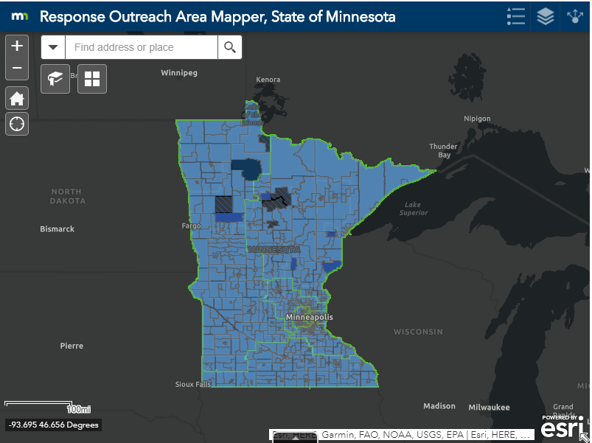
Find your community:
Notes:
This map is the percent who are likely to not self respond to the census. This means they will not fill out online or paper version and will likely have a census-worker at their door.

Slide 35
Census Tract
Notes:
Explain what this is, a census tract could be multiple zipcodes

Slide 36
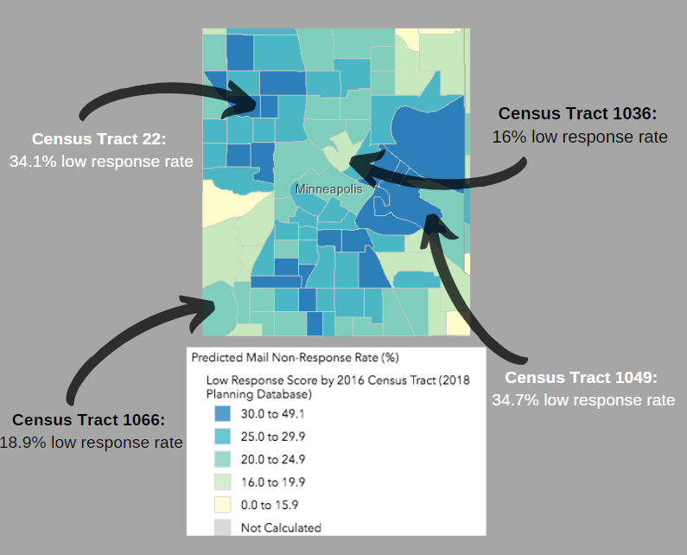
An undercount can disproportionally impact our communities.
An undercount results in the misallocation of funds, depriving our community of the resources they deserve.
Notes:
explain map and why we need to ensure that these communities are counted
University of Minnesota in census tract 1049…one of the groups likely to be missed.

Slide 37
Communities remain invisible.

Slide 38
Why do you care about obtaining a complete count in your community?
Notes:
I think it is important to think about our own why? Why do you care? Our passion for this work will permeate into the communities but we need to know the why behind our passion.

Slide 39
Preventing an undercount

Slide 40
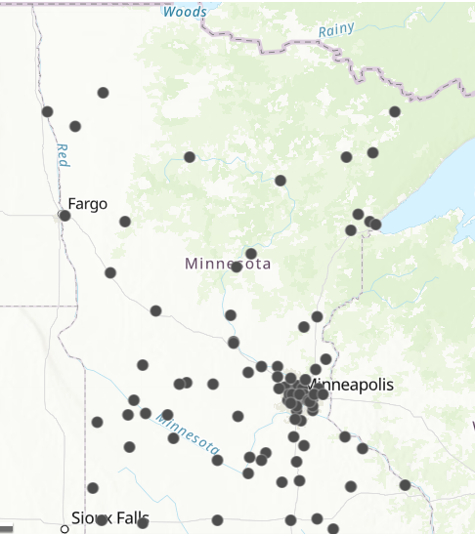
Partnerships
Complete Count Committees in Minnesota
What is a Complete Count Committee?
Activists, community organizations, local governments, and everyday citizens all have a part to play in the success of the 2020 Census.
Notes:
Partnerships are essential. This is a 4 person team at the state and we need a multifaceted approach. Explain this is the statewide CCC map.
Name specific CCC for instance this is thief river falls ccc and the map will show the contact name etc for this ccc

Slide 41
Tools to prevent an undercount
1. Commit to be Counted Forms (C2BC)
Email content
2. Help Desk
3. Content:
Handouts from the State and Census
Graphics
Videos
4. Newsletter
5. Social Media
6. Community Outreach
Tabling toolkit
Apartment toolkit
7. Census Marketing
Materials
Notes:
Tools to prevent an undercount. I will review each tool. The tools are a menu of options to prevent an undercount but think about what will work in your own community. This is . *You’re an expert in conversing in your community.

Slide 42
One size does not fit all
Notes:
Remember you know your community so pick and choose what works for you! We are a member of multiple communities (example: personal)

Slide 43
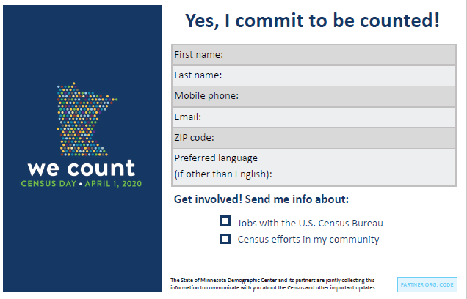
Commit to be Counted (C2BC)
Notes:
C2BC: collect digital information about people you have talked to about the census and send back with a reminder message and out intent is to make this easy for you to do this outreach. Tools to collect information from your students and take phone numbers and emails to remind about census. Explain where we have this tool effective as an office.

Slide 44
Commit to be Counted (C2BC) Instructions
1. Print off C2BC and embed the C2BC form on your organizations website. Every C2BC will have a unique code.
2. Attend or organize a community event and ask people there to commit to be counted!
3. Send all physical forms to me (Rachel.dame@state.mn.us) within one-week of the event.
4. The State Demographic Center (that is us!) will follow up with your CCC to provide the contact information for the individuals in your community that completed the form.
* Remember C2BC is for CCC partners
Notes:
-Add blurb at the end about data privacy

Slide 45
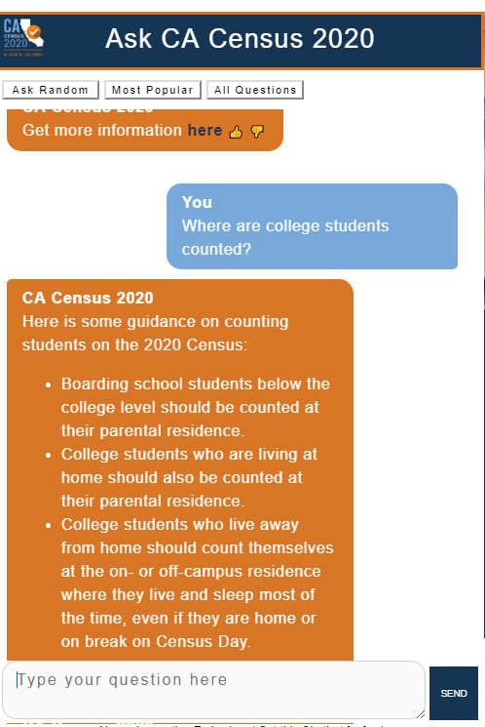
Help Desk
Available in: Hmong, Somali, and Spanish.
Answers remain anonymous.
Page linked to the Census FAQ’s page.
Notes:
Anything not answered will be covered by a volunteer within 24 hours and talk about the language features
Demo question about college students

Slide 46
Content (located on Census Website)
State handouts and Census Handouts
Graphics:
Unlocked logos
Banner for website
Videos:
English only:
Census 101: Census Overview
Census 102: Confidentiality
How Confidential is the Census?
Census Day
Minnesota Could be a big loser in 2020
Student video (University and College specific)
Spanish, Somali, and Hmong:
Census 101 and 102 (combined)
Animation video on Confidentiality and Citizenship
Notes:
Student Video is coming in October, we are starting the process of filming this video. The language specific videos for Census 1010 and 102 will be ready this fall and the animated confidentiality/citizenship video will be ready in January.

Slide 47
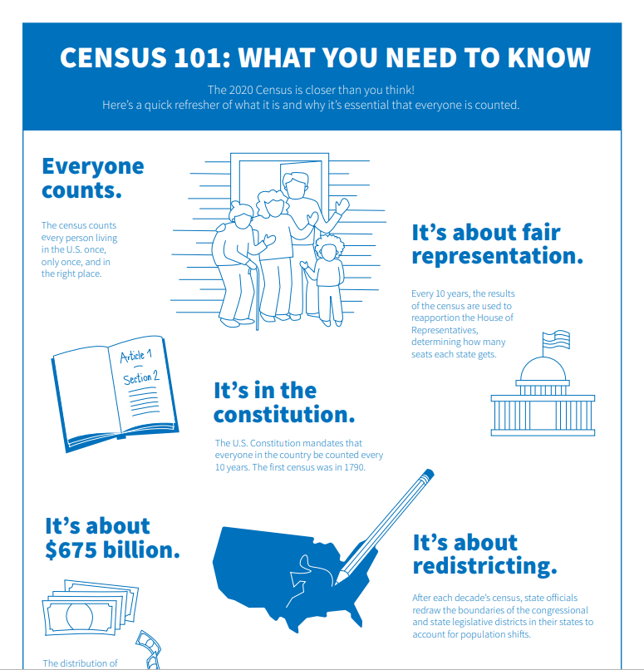
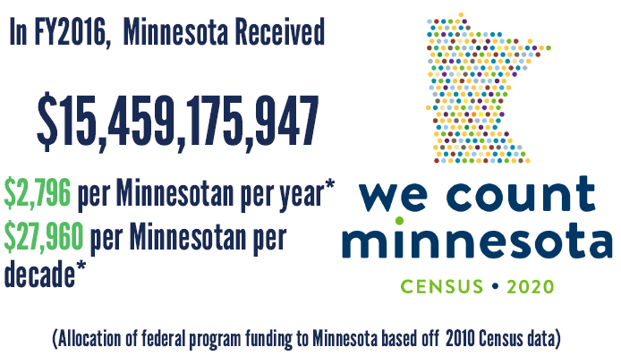
Handouts (website)

Slide 48
Logos (unlocked)
Notes:
Content that partners can place in their newsletter so they can receive regular content from us on different topics like jobs with the bureau

Slide 49
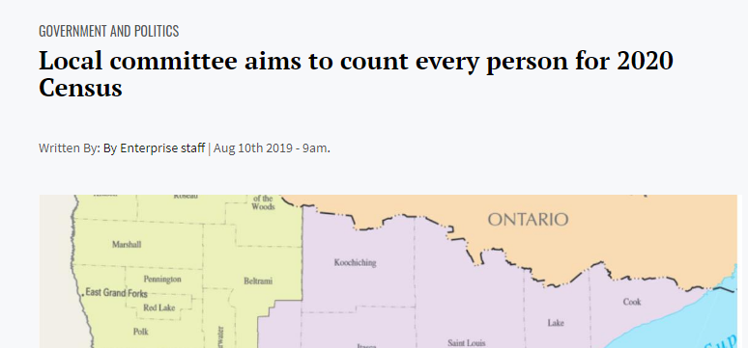
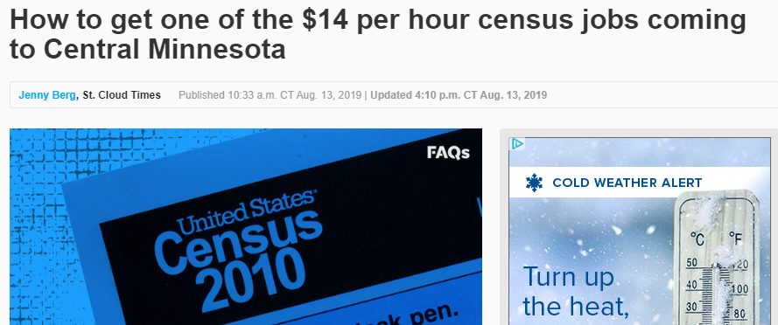
Newsletter Content
Notes:
Content that partners can place in their newsletter so they can receive regular content from us on different topics like jobs with the bureau

Slide 50
Social Media
Twitter: @MN2020Census
Facebook: @MN2020Census – Profile name: Minnesota 2020 Census
Instagram: @MN2020Census – Profile name: Minnesota Census
#WeCountMN
Notes:
Some of the goals for connecting with this account would be expanding the reach of a partner’s work and keeping up to date on new materials/being reminded of old materials. We do want to grow our audience on these so we can directly remind people about the big day.
Add the census bureau frames and table of tweets or they can use what we will create

Slide 51
Tabling Toolkit
Sample tabling activities and timeline
Census event calendar
Host a census workshop
Host a Census Response Table during April, 2020
Sample script on how to speak with members of the community
Census Community Outreach Toolkit and additional tips
Notes:
Describe a census response table first and we will work to what you need for tabling. Tabling for activities that have in late spring

Slide 52
Tabling Toolkit
Sample tabling activities and timeline
Census event calendar
Host a census workshop
Host a Census Response Table during April, 2020
Sample script on how to speak with members of the community
Census Community Outreach Toolkit and additional tips
Notes:
Describe a census response table first and we will work to what you need for tabling. Tabling for activities that have in late spring

Slide 53
Census Materials
(Coming soon!) purchase option through our website. Available materials are:
We Count T-Shirts and Census Nerd T-Shirts
Buttons
Stickers
Tote Bags
Coffee Mugs and Travel Mugs
Yard Signs
Notes:
If you have a grant, then you can use your money to buy this stuff.

Slide 54
Jobs with the census
Qualifications:
Be at least 18 years old by April 1, 2020.
Have a valid social security number.
Be a U.S. citizen.
Have a valid email address.
Be available to work flexible hours, including some day, evenings, and weekends.
Pass a U.S. Census criminal background check.*
Be registered with the Selective Service System, or have a qualifying exemption, if you are male and were born after December 31, 1959.
Some specific positions require employees to have access to a vehicle and maintain a valid driver’s license.
The Census Bureau is hiring now:
https://2020census.gov/en/jobs
Notes:
The best person to about the census in your community is you!

Slide 55
Community Outreach
Apartment toolkit (coming soon!)

Slide 56
Gov Delivery

Slide 57
Community Outreach: What are some ways you would conduct census engagement in your community?
Notes:
Interaction portion. After seeing these tools what are way that you can conduct census outreach in your own community. Talk at table and right 3-4 (or more) ways and we will report back to the group. If hiding the remaining slides, mention that in future trainings there will be a design thinking portion.

Slide 58
We are not meant to know everything.
Notes:
COME back and remember not meant to know everything. Personal canvassing story.

Slide 59
72 years
2092
Notes:
Does anyone remember how long your census data is protected? Does anyone remember the year?

Slide 60
Who is our idea designed for?
What is a tool, campaign, program, or other activity we can create?
How are people going to find out about it?
How does it make people feel?
Who can we partner with?
What are the existing resources on the table to pull this off?
What is the call to action?
Notes:
Come back to your group after seeing these ideas, remember this isn’t a one size fits all approach but each group or table as a different scenario. Thinking of the tools and your knowledge of the census how would communicate with this community member. Be prepared to pitch your idea and keep these questions in mind.

Slide 61
Pitch and Discuss
Describe your user
Identify the users barrier to Census participation
Walk through your idea with the group
What resources are needed?
Group feedback
Notes:
REPORT back

Slide 62
Follow up from the State: Contact: Rachel Dame Rachel.Dame@state.mn.us 336-409-5467 ALL the handouts and information from today will be located on our website under the “Training” tab.
Notes:
Follow up from state and contact info
Review packet: example c2bc and instructions, helpdesk overview, scenario, counting for dollars, census script for canvassing, information about jobs with the census,

Slide 63
Questions?
Notes:
Remaining questions from the group

