Slide 1
Census 2020: What Story to Tell
Notes:
Project Overview
§ Research
Scan of Existing Research
Quantitative Surveys & Qualitative Exploration
Survey 1 – see if we can identify people who will care
Survey 2 – see whether there are particular issues that highly engaged people see as relevant/connected to the Census
Richmond VA focus group – women of any race who are liberal Dems / men and women POCs who are active online or in their community and are fired up about the citizenship question
Denver CO focus group – men and women of any race who are somewhat willing to take action in their community or online / white men Independent/Moderate/Lean Repub who are active online or in their community
Results, Analysis & Insights
§ Narrative Development
- Creative Session
- Scan of Existing Messaging
- Creative Development
- Narrative Field Experiments
- Narrative & Engagement Guide

Slide 2
Flat talking points
Wonky ≠ motivation
“Dangling” claims and evidence
Notes:
Flat talking points do not evoke emotion
Wonky expressions do not educate/resonate/motivate
“Dangling” claims and evidence create gaps/disbelief (we say that the census is important, but not why. We say the census has impact, but not what it is).

Slide 3
This is among the most important civil rights issues of our day…
The census is the foundation of our democracy, and we must guarantee that everyone gets counted…
A fair and accurate census is essential: the 2020 census must be well-funded with a highly qualified and established leader as census bureau director…
Your civil rights are on the line. Completing the 2020 Census plays a key role in ensuring accurate representation for all…
Notes:
Dangling claims are the most egregious. Too many of our messages are flat and communicate vital information in abstract ways.
We have to make the census real for people. We cannot assume it’s self-evident or that saying it’s critical to our democracy or how we fund public programs if we can’t make that real.
WHY is the census essential.
WHY is it foundational to our democracy
WHY are our rights on the line
WHAT DOES THIS MEAN FOR ME RIGHT NOW SITTING AT HOME?

Slide 4
Our goal isn’t to convince people that the census is important.
It’s to spark and channel true passion.
Notes:
What this means is that we have to make the census real for people. They have to see it as central to their lives as voting or education.
And do to that we have to tell a story that makes these connections and evokes an emotional reaction.

Slide 5
Identify resources missing from people’s lives and link directly to the census.
Notes:
The narrative we tested is MISSING.
It’s a story that makes a connection between the census – which happens every 10 years – and people’s every day experiences. And importantly, it also fills in a crucial element about why things are the way they are. It’s not just that our elected leaders made choices one way or another; it’s that we are not showing up for this important part of being a citizen the way we do when we vote, or pay taxes, or call our senators. The census is an important part of all of that.
It helps to make the census real.

Slide 6
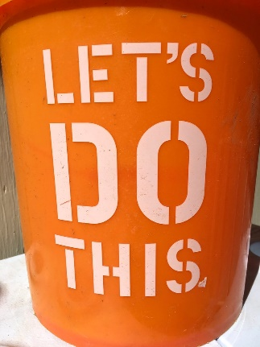
Notes:
THREE KEY INGREDIENTS:
1. CONNECTING
Forging a connection between what people feel most invested in, and the goals we’ve set for influencing the census. That is, tapping into their motivations: their values, cares and wants in life.
2. CONVERGING
Focusing people’s attention, energy and action on a few key moments in which everything is at stake: make or break moments for our fight, and therefore for the values and wants that are most important to them. That is, clarifying exactly when we will either win or lose something related to what the census will be and how it will affect us.
3. CALLING TO ACTION
Offering a path to action that is exciting, meaningful and strategic—providing a clear and compelling understanding of how, when and why their actions will help win something real.

Slide 7
If we skip the census, the census will skip us.
I am done seeing us miss out: seeing our communities go without what we deserve. Missing out on the same Medicaid that other states get. Missing funding for the schools that 24 million kids from low-income families go to. And missing their school lunches. Missing the federally-funded spots in child care centers that parents depend on.
I am done being missed. That’s why I’m going to fill out my census form in 2020. You should too. Don’t be missed.

Slide 8
That means we have to look ahead and see
what’s coming.
You know what Tuesday, November 3, 2020 is,
right? You know that date?
That’s the date when we can change what
happens in this country.
But do you know what Wednesday, April 1, 2020 is?
That’s the date when we first get to decide what matters in our communities. That day we fill out the census form and make sure we get the schools, hospitals, and roads that our communities need.

Slide 9
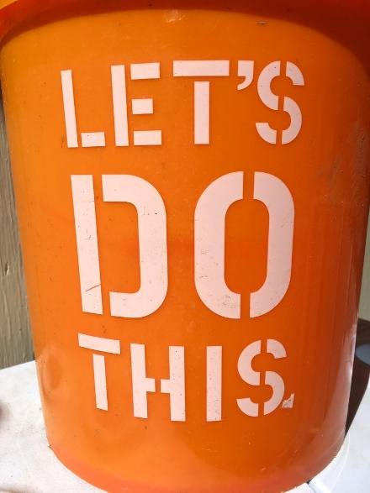
We can get what’s missing in our communities. It begins with saying what we need.
It begins with the Census.
If we are on the streets, and on the news, and even in the polling booth, but not in the Census, we will continue to look around and find that the things we need are still missing.
We are not going to let that happen.
We have to fill out the form. We have to make sure our neighbors do too.

Slide 10
Summary
Make the Census REAL.
Emotion, not Education
Connection > Convergence > Call to Action
Notes:
Make sure that you’re making the census – why it matters and its TANGIBLE impact – real for people. The more specific you can be, the better.
Your messages should have emotional elements to it. They should make people feel.
Connect to what people already care about, drive them in the right direction, so they can act!

